Slide 1

ONLINE BOOKSTORE DATABASE -SQL PROJECT BY RAMYA KANCHARLA

Slide 2
Introduction
Online shopping is increasing So , Bookstores are moving online
Need for database system
For Manages books, customers, orders,Authors
That is Built using SQL
Ensures efficient data storage and retrieval
Project Objectives
1. To design a normalized relational database schema.
2. To enforce data integrity using constraints such as PRIMARY KEY and FOREIGN KEY.
3. To implement efficient data retrieval using SQL queries.
4. To perform analytical operations using aggregate functions.
5. To simulate real-world e-commerce operations like order processing and payments.

Slide 3
The project follows database design principles:
1.Conceptual Design - Identification of entities (Customers, Books, Orders, etc.) , Establishing relationships between entities
2. Normalization - Ensuring database is in Third Normal Form (3NF) , Eliminating redundancy and dependency issues
3. Implementation - Creating tables using SQL , Defining constraints (PK, FK, NOT NULL, UNIQUE)
4. Query Processing - Using SQL commands for data retrieval and analysis
5.Automating and Maintaining Consistency of a Database

Slide 4
What is database and sql
What is a Database?
A database is a collection of organized data stored electronically
It allows easy storage, retrieval, and management of data
Used in applications like banking, shopping, and student systems
👉 Example: Student database (Name, ID, Marks)
What is a SQL?
SQL (Structured Query Language) is used to interact with databases
It helps to create, read, update, and delete data (CRUD operations)
WE USE DQL,DML,DDL,TCL in the SQL ,lets us learn about them in detail later

Slide 5
enTities and attributes of this database
IN ONLINE BOOKSTORE DATABASE,
1. Authors
author_id (PK)
first_name
last_name
bio
country
2. Categories
category_id (PK)
category_name
description
3. Publishers
publisher_id (PK)
publisher_name
country
website
4. Books
book_id (PK)
title
author_id (FK)
category_id (FK)
publisher_id (FK)
price
stock_quantity
published_date
isbn
language
pages
5. Customers
customer_id (PK)
first_name
last_name
email
phone
address
city
country
registration_date
6. Orders
order_id (PK)
customer_id (FK)
order_date
total_amount
status
shipping_address
8. Payments
payment_id (PK)
order_id (FK)
payment_date
amount
payment_method
payment_status
9. Reviews
review_id (PK)
book_id (FK)
customer_id (FK)
rating
review_text
review_date
7. Order_Items
order_item_id (PK)
order_id (FK)
book_id (FK)
quantity
unit_price

Slide 6
Creating a database and inserting values into it :
CREATE DATABASE IF NOT EXISTS OnlineBookStore;
USE OnlineBookStore;
CREATE TABLE Authors ( author_id INT PRIMARY KEY AUTO_INCREMENT, first_name VARCHAR(50) NOT NULL, last_name VARCHAR(50) NOT NULL, bio TEXT, country VARCHAR(50));
CREATE TABLE Categories ( category_id INT PRIMARY KEY AUTO_INCREMENT, category_name VARCHAR(100) NOT NULL, description TEXT);
CREATE TABLE Publishers ( publisher_id INT PRIMARY KEY AUTO_INCREMENT, publisher_name VARCHAR(100) NOT NULL, country VARCHAR(50), website VARCHAR(100));
CREATE TABLE Books ( book_id INT PRIMARY KEY AUTO_INCREMENT, title VARCHAR(200) NOT NULL, author_id INT, category_id INT, publisher_id INT, price DECIMAL(10,2) NOT NULL, stock_quantity INT DEFAULT 0, published_date DATE, isbn VARCHAR(20) UNIQUE, language VARCHAR(30) DEFAULT 'English', pages INT, FOREIGN KEY (author_id) REFERENCES Authors(author_id), FOREIGN KEY (category_id) REFERENCES Categories(category_id), FOREIGN KEY (publisher_id) REFERENCES Publishers(publisher_id));
CREATE TABLE Customers ( customer_id INT PRIMARY KEY AUTO_INCREMENT, first_name VARCHAR(50) NOT NULL, last_name VARCHAR(50) NOT NULL, email VARCHAR(100) UNIQUE NOT NULL, phone VARCHAR(15), address TEXT, city VARCHAR(50), country VARCHAR(50), registration_date DATE DEFAULT (CURRENT_DATE));

Slide 7
CREATE TABLE Orders ( order_id INT PRIMARY KEY AUTO_INCREMENT, customer_id INT, order_date DATETIME DEFAULT CURRENT_TIMESTAMP, total_amount DECIMAL(10,2), status ENUM('Pending', 'Confirmed', 'Shipped', 'Delivered', 'Cancelled') DEFAULT 'Pending', shipping_address TEXT, FOREIGN KEY (customer_id) REFERENCES Customers(customer_id));
CREATE TABLE Order_Items ( order_item_id INT PRIMARY KEY AUTO_INCREMENT, order_id INT, book_id INT, quantity INT NOT NULL, unit_price DECIMAL(10,2) NOT NULL, FOREIGN KEY (order_id) REFERENCES Orders(order_id), FOREIGN KEY (book_id) REFERENCES Books(book_id));
CREATE TABLE Reviews ( review_id INT PRIMARY KEY AUTO_INCREMENT, book_id INT, customer_id INT, rating INT CHECK (rating BETWEEN 1 AND 5), review_text TEXT, review_date DATE DEFAULT (CURRENT_DATE), FOREIGN KEY (book_id) REFERENCES Books(book_id), FOREIGN KEY (customer_id) REFERENCES Customers(customer_id));
CREATE TABLE Payments ( payment_id INT PRIMARY KEY AUTO_INCREMENT, order_id INT, payment_date DATETIME DEFAULT CURRENT_TIMESTAMP, amount DECIMAL(10,2), payment_method ENUM('Credit Card', 'Debit Card', 'UPI', 'Net Banking', 'Cash on Delivery'), payment_status ENUM('Success', 'Failed', 'Pending') DEFAULT 'Pending', FOREIGN KEY (order_id) REFERENCES Orders(order_id));

Slide 8
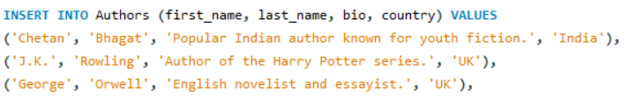





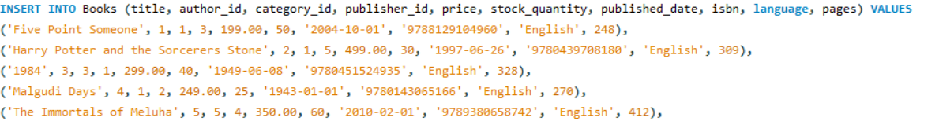
Sample data of inserting values to the created tables;

Slide 9
Basic dql queries
Now the data is ready for using Queries,
SELECT Query Retrieves data from one or more columns in a table. Use * to fetch all columns or specify column names to get only what you need.
Example: SELECT Title, Author, Price FROM Books; → Retrieves the title, author, and price of all books in the bookstore
LIST (IN) Operator Checks if a value matches any value in a given list. Cleaner shorthand for multiple OR conditions.
Example: SELECT * FROM Orders WHERE Status IN ('Shipped', 'Delivered', 'Pending'); → Returns all orders that are either Shipped, Delivered, or Pending
Nullable (IS NULL) Operator Checks for NULL (missing or unknown) values. Always use IS NULL or IS NOT NULL — never = NULL.
Example: SELECT * FROM Books WHERE Description IS NULL; → Finds all books that have no description entered in the database
WHERE Clause Filters rows based on a condition. Only rows that satisfy the condition appear in the result.
Example: SELECT * FROM Books WHERE Price > 500; → Returns only books that cost more than ₹500
LIKE Operator Used for pattern matching in text columns. % matches any number of characters, _ matches exactly one character.
Example: SELECT * FROM Books WHERE Title LIKE '%Harry%'; → Finds all books that have the word 'Harry' anywhere in the title

Slide 10
String Operators & Functions Used to manipulate and search text data stored in columns. Common functions: CONCAT, UPPER, LOWER, SUBSTRING, TRIM.
CONCAT → SELECT CONCAT(FirstName, ' ', LastName) AS CustomerName FROM Customers; → Combines first and last name of each customer into one full name
UPPER → SELECT UPPER(Genre) FROM Books; → Converts all genre names to uppercase (e.g., fiction → FICTION)
SUBSTRING → SELECT SUBSTRING(Title, 1, 10) FROM Books; → Extracts the first 10 characters of each book title
Date Functions Built-in functions to extract, compare, and format date/time values in the database.
NOW() → SELECT NOW(); → Returns the current date and time (useful for logging order placed time)
YEAR() / MONTH() → SELECT YEAR(OrderDate) FROM Orders; → Extracts the year from when each order was placed
DATEDIFF() → SELECT DATEDIFF(DeliveryDate, OrderDate) FROM Orders; → Calculates how many days it took to deliver each order
DATE_FORMAT() → SELECT DATE_FORMAT(OrderDate, '%d-%m-%Y') FROM Orders; → Displays the order date in DD-MM-YYYY format

Slide 11
COMBINING TABLES WITH JOINS:
INNER JOIN Returns only the rows where there is a matching value in both tables.
Non-matching rows are excluded.
Example: SELECT Customers.Name, Orders.OrderID FROM Customers INNER JOIN Orders ON Customers.CustomerID = Orders.CustomerID;
→ Returns only customers who have placed at least one order — customers with no orders are not shown
LEFT JOIN Returns all rows from the left table and the matching rows from the right table.
If no match, NULL is shown for right table columns.
Example: SELECT Customers.Name, Orders.OrderID FROM Customers LEFT JOIN Orders ON Customers.CustomerID = Orders.CustomerID;
→ Returns all customers including those who have never placed an order (their OrderID shows as NULL)
RIGHT JOIN Returns all rows from the right table and the matching rows from the left table. If no match, NULL is shown for left table columns.
SELECT Customers.Name, Orders.OrderID FROM Customers RIGHT JOIN Orders ON Customers.CustomerID = Orders.CustomerID;
→ Returns all orders including any that may not be linked to a valid customer record
FULL OUTER JOIN Returns all rows from both tables.
Shows NULL where there is no match on either side. NOT AVAILABLE IN MSQL YOY CAN DO IT BY UNION OPERATOR
SELECT Customers.Name, Orders.OrderID FROM Customers FULL OUTER JOIN Orders ON Customers.CustomerID = Orders.CustomerID;
→ Returns all customers and all orders — unmatched rows on either side show NULL

Slide 12
Primary Key A column that uniquely identifies each row in a table. It cannot be NULL or duplicate.
Example: CREATE TABLE Books (BookID INT PRIMARY KEY, Title VARCHAR(100), Price DECIMAL); → BookID uniquely identifies every book in the bookstore — no two books can share the same BookID
Foreign Key A column in one table that references the Primary Key of another table. It creates a link between two tables.
Example: CREATE TABLE Orders (OrderID INT PRIMARY KEY, CustomerID INT, FOREIGN KEY (CustomerID) REFERENCES Customers(CustomerID)); → CustomerID in Orders links to the Customers table — ensures only valid customers can place orders
Composite Key A Primary Key made up of two or more columns together to uniquely identify a row.
Example: CREATE TABLE OrderItems (OrderID INT, BookID INT, PRIMARY KEY (OrderID, BookID)); → A single order can have multiple books — combining OrderID + BookID together makes each row unique
ORDER BY Clause Sorts the result in ascending (ASC) or descending (DESC) order based on a column. Default is ASC.
Example: SELECT Title, Price FROM Books ORDER BY Price DESC; → Displays all books from most expensive to least expensive
LIMIT Clause Restricts the number of rows returned by a query. Useful for showing top results or paginating data.
Example: SELECT Title, Price FROM Books ORDER BY Price DESC LIMIT 5; → Returns only the 5 most expensive books in the bookstore

Slide 13
Summarize and organise with queries
Aggregate Functions:
1. SUM: adds up all values in a column. Used to calculate total money earned from all orders.
Example: SELECT SUM(total_amount) AS total_revenue FROM Orders; → Returns the total revenue generated from all orders in the bookstore
2.COUNT: COUNT returns the number of rows matching a condition. Used to track transactions or orders.
Example: SELECT COUNT(*) AS total_payments FROM Payments; → Returns the total number of payments made in the bookstore
3.Average (AVG): AVG calculates the mean of a numeric column. Helps understand typical spending per order.
Example: SELECT AVG(total_amount) AS avg_order_value FROM Orders; → Returns the average amount spent per order
4.MAX / MIN : MAX and MIN return the largest and smallest values in a column respectively.
Example: SELECT MAX(price) AS highest_price, MIN(price) AS lowest_price FROM Books; → Returns the most expensive and cheapest book in the bookstore
GROUP BY with Filtering (HAVING) : GROUP BY groups rows by a column. HAVING filters those groups — like WHERE but for grouped results.
Example: SELECT c.first_name, COUNT(o.order_id) AS order_count FROM Customers c JOIN Orders o ON c.customer_id = o.customer_id GROUP BY c.customer_id HAVING order_count > 2; → Returns only customers who have placed more than 2 orders

Slide 14
ANALYSIS AND INSIGHTS OF DATA:
Book Sales Analysis (JOIN + SUM) JOIN combines data from multiple tables. SUM totals the quantity sold per book across all orders.
Example: SELECT b.title, SUM(oi.quantity) AS total_sold FROM Books b JOIN Order_Items oi ON b.book_id = oi.book_id GROUP BY b.book_id ORDER BY total_sold DESC LIMIT 1; → Returns the single best-selling book in the bookstore
Revenue Per Book (Calculated Column) Multiply quantity × unit_price inside SUM to calculate revenue generated by each book.
Example: SELECT b.title, SUM(oi.quantity * oi.unit_price) AS revenue FROM Books b JOIN Order_Items oi ON b.book_id = oi.book_id GROUP BY b.book_id ORDER BY revenue DESC; → Returns each book along with the total revenue it has generated
Author Revenue (Multi-table JOIN) Multiple JOINs chain three or more tables together to pull combined insights across Authors, Books, and Orders.
Example: SELECT a.first_name, SUM(oi.quantity * oi.unit_price) AS total_revenue FROM Authors a JOIN Books b ON a.author_id = b.author_id JOIN Order_Items oi ON b.book_id = oi.book_id GROUP BY a.author_id ORDER BY total_revenue DESC; → Returns each author ranked by how much revenue their books have generated

Slide 15
Category-wise Revenue Groups sales data by book category to identify which genre earns the most.
Example: SELECT c.category_name, SUM(oi.quantity * oi.unit_price) AS revenue FROM Categories c JOIN Books b ON c.category_id = b.category_id JOIN Order_Items oi ON b.book_id = oi.book_id GROUP BY c.category_id ORDER BY revenue DESC;
→ Returns each book category ranked by total revenue earned
Monthly Revenue (DATE_FORMAT) DATE_FORMAT extracts and formats date parts. Grouping by month shows revenue trends over time.
Example: SELECT DATE_FORMAT(order_date, '%Y-%m') AS month, SUM(total_amount) AS revenue FROM Orders GROUP BY month ORDER BY month;
→ Returns total revenue earned each month in chronological order
CASE WHEN (Conditional Aggregation) CASE WHEN applies conditions inside aggregate functions to calculate multiple metrics in a single query.
Example: SELECT COUNT(*) AS total_payments, SUM(CASE WHEN payment_status = 'Pending' THEN 1 ELSE 0 END) AS pending_payments, SUM(CASE WHEN payment_status = 'Success' THEN amount ELSE 0 END) AS total_revenue FROM Payments;
→ Returns total payments, pending count, and successful revenue all in one result row

Slide 16
Retrieve data with Sub queries
What is a Subquery? A subquery is a query written inside another query. The inner query runs first and passes its result to the outer query.
Scalar Subquery
Returns a single value (one row, one column). Used with operators like =, >, < to compare against that one value.
Books priced above average
SELECT title, price FROM Books WHERE price > (SELECT AVG(price) FROM Books); → The inner query finds the average book price, outer query returns all books costing more than that
Most expensive book
SELECT * FROM Books WHERE price = (SELECT MAX(price) FROM Books); → The inner query finds the highest price, outer query returns the full details of that book
Orders above average order value
SELECT * FROM Orders WHERE total_amount > (SELECT AVG(total_amount) FROM Orders); → Returns all orders where the amount spent is higher than the average order value
Tabular Subquery Returns multiple rows. Used with IN or NOT IN to check if a value exists in that list of results.
Books in Fiction category
SELECT title FROM Books WHERE category_id IN (SELECT category_id FROM Categories WHERE category_name = 'Fiction’); → Inner query gets the Fiction category ID, outer query returns all books belonging to that category
Books that were never ordered
SELECT title FROM Books WHERE book_id NOT IN (SELECT book_id FROM Order_Items); → Inner query gets all ordered book IDs, outer query returns books that never appear in any order
Authors who wrote Mythology books
SELECT first_name FROM Authors WHERE author_id IN (SELECT author_id FROM Books WHERE category_id IN (SELECT category_id FROM Categories WHERE category_name = 'Mythology')); → Nested subqueries find the Mythology category, then matching books, then returns those authors

Slide 17
Correlated Subquery A subquery that runs once for every row of the outer query. It refers to a column from the outer query, so it cannot run independently.
Books priced above their own category average
SELECT b.title, b.price FROM Books b WHERE b.price > (SELECT AVG(price) FROM Books WHERE category_id = b.category_id); → For each book, the inner query calculates the average price of only that book's category and compares
Books that sold more than average quantity
SELECT b.title FROM Books b WHERE (SELECT SUM(oi.quantity) FROM Order_Items oi WHERE oi.book_id = b.book_id) > (SELECT AVG(quantity) FROM Order_Items); → For each book, total quantity sold is compared against the overall average quantity per order item
Authors whose books earned more than average author revenue
SELECT a.first_name FROM Authors a WHERE (SELECT SUM(oi.quantity * oi.unit_price) FROM Books b JOIN Order_Items oi ON b.book_id = oi.book_id WHERE b.author_id = a.author_id) > (SELECT AVG(author_revenue) FROM (SELECT SUM(oi.quantity * oi.unit_price) AS author_revenue FROM Books b JOIN Order_Items oi ON b.book_id = oi.book_id GROUP BY b.author_id) AS temp); → For each author, their total revenue is compared against the average revenue across all authors

Slide 18
modify and manage data using dml
INSERT Query Used to add new records into a table. Values must match the column order and data types defined in the table.
Insert a new book
INSERT INTO Books (title, author_id, category_id, publisher_id, price, stock_quantity, published_date, isbn, language, pages) VALUES ('Learning SQL Basics', 21, 11, 11, 399.00, 25, '2023-01-01', '9781234567890', 'English', 320);
→ Adds a new book called 'Learning SQL Basics' with all its details into the Books table
Insert a new order
INSERT INTO Orders (customer_id, total_amount, status, shipping_address) VALUES (31, 399.00, 'Pending', '12 Main Road, Nellore’);
→ Creates a new order for customer 31 with a Pending status
Insert multiple customers at once
INSERT INTO Customers (first_name, last_name, email, phone, address, city, country) VALUES ('Kiran', 'Naidu', 'kiran.naidu@gmail.com', '9876540000', 'Street 1', 'Vizag', 'India'), ('Megha', 'Sharma', 'megha.sharma@gmail.com', '9876541111', 'Street 2', 'Delhi', 'India’);
→ Inserts two customer records in a single INSERT statement
UPDATE Query Used to modify existing records in a table. Always use WHERE clause to avoid updating all rows accidentally.
Update book price
UPDATE Books SET price = 450.00 WHERE book_id = 31;
→ Changes the price of book with ID 31 to ₹450
Give 10% discount to expensive books
UPDATE Books SET price = price * 0.9 WHERE price > 500; → Reduces the price of all books above ₹500 by 10%
Update multiple columns at once
UPDATE Books SET price = 300.00, stock_quantity = 40 WHERE book_id = 2;
→ Updates both the price and stock quantity of book ID 2 in a single query
Increase stock after restocking
UPDATE Books SET stock_quantity = stock_quantity + 10 WHERE book_id = 31;
→ Adds 10 more copies to the existing stock of book ID 31

Slide 19
DELETE Query Used to remove existing records from a table. Always use WHERE clause to target specific rows — without it, all records will be deleted.
Delete low rated reviews
DELETE FROM Reviews WHERE rating < 3;
→ Removes all reviews from the bookstore that have a rating below 3
Delete cancelled orders
DELETE FROM Orders WHERE status = 'Cancelled’;
→ Cleans up the Orders table by removing all orders marked as Cancelled
Delete failed payments
DELETE FROM Payments WHERE payment_status = 'Failed’;
→ Removes all failed payment records from the Payments table
Indexes An index is a database object that speeds up data retrieval. It works like a book index — instead of scanning every row, MySQL directly jumps to the needed data. Improves SELECT query performance but slightly slows INSERT and UPDATE.
Create an index on Book title
CREATE INDEX idx_book_title ON Books(title);
→ Speeds up searches when customers search a book by its title — no full table scan needed
Create an index on Customer email
CREATE INDEX idx_customer_email ON Customers(email);
→ Makes login and customer lookup by email much faster
Create an index on Order date
CREATE INDEX idx_order_date ON Orders(order_date);
→ Speeds up monthly revenue and date-based filtering queries on the Orders table
Drop an index
DROP INDEX idx_book_title ON Books;
→ Removes the index from the Books table when it is no longer needed

Slide 20
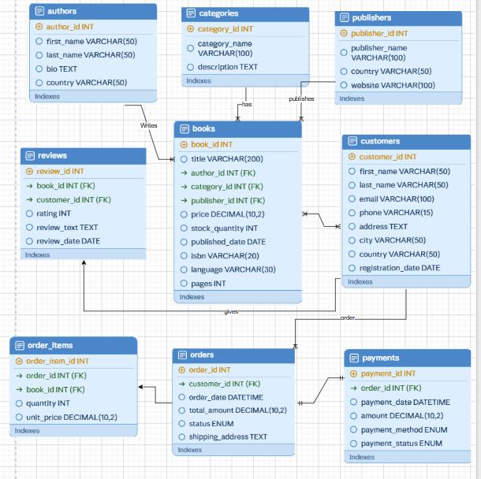
ER diagram of Onlinebookstore Database:
Author
Categories
Publishers
Reviews
Books
Customers
Orders
Order_items
payments

Slide 21
One-to-Many (1:M) Relationships
These are the most common type in this database
Authors → Books: One author can write many books
Categories → Books: One category can classify many books
Publishers → Books: One publisher can publish many books, but each book has one publisher.
Customers → Orders: One customer can place many orders over time, but each order belongs to one customer.
Orders → Order_Items: One order can contain many items (multiple books), but each order item belongs to one order.
Books → Order_Items: One book can appear in many different orders, but each order item refers to one book.
Books → Reviews: One book can receive many reviews from different customers.
Customers → Reviews: One customer can write many reviews for different books.
One-to-One (1:1) Relationship
Orders → Payments: Each order has exactly one payment record, and each payment belongs to exactly one order. This is a strict 1:1 link.
Many-to-Many (M:M) — Resolved via Bridge Table
Books ↔ Customers (through Orders + Order_Items): A customer can buy many books, and a book can be bought by many customers. This M:M relationship is resolved using Orders and Order_Items as a bridge.
Books ↔ Customers (through Reviews): A customer can review many books, and a book can be reviewed by many customers.
The Reviews table acts as the bridge here.

Slide 22
Normalization
Normalization is a process in databases used to organize data efficiently by reducing redundancy (duplicate data) and improving data integrity (accuracy and consistency).
🔹 1NF (First Normal Form) No repeating or multiple values in a column
Data must be atomic (single value)
🔹 2NF (Second Normal Form) Must follow 1NF
No partial dependency (depends on full primary key)
🔹 3NF (Third Normal Form) Must follow 2NF
No transitive dependency (non-key → non-key not allowed)
🔹 BCNF (Boyce-Codd Normal Form) Stronger version of 3NF
Every determinant must be a candidate key

Slide 23
Define database schema with ddl commands
DDL (Data Definition Language)
Definition: DDL stands for Data Definition Language. It is a subset of SQL used to define, modify, and manage the structure of database objects like tables, schemas, indexes, and constraints. DDL commands do not deal with the actual data inside tables — they deal with the structure of the database.
Key DDL Commands:
Command | Purpose
CREATE | Creates a new database object (table, view, index)
ALTER | Modifies an existing database object
DROP | Permanently deletes a database object
TRUNCATE | Removes all rows from a table but keeps its structure
RENAME | Renames an existing database object
DDL commands are auto-committed — changes are saved immediately and cannot be rolled back
DDL defines the schema of the database
DDL commands affect the metadata stored in the data dictionary
Constraints like PRIMARY KEY, FOREIGN KEY, UNIQUE, NOT NULL, and CHECK are enforced through DDL

Slide 24
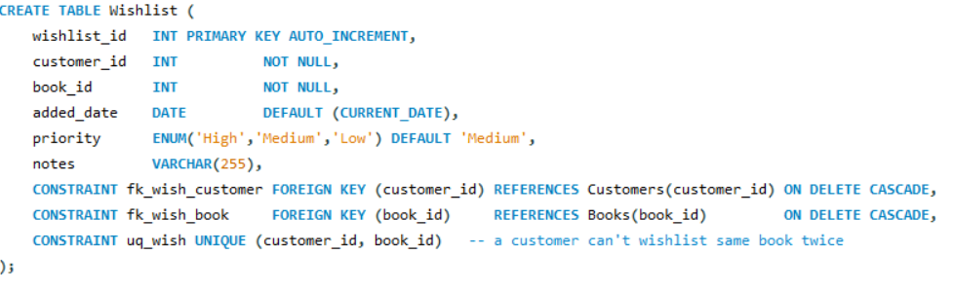
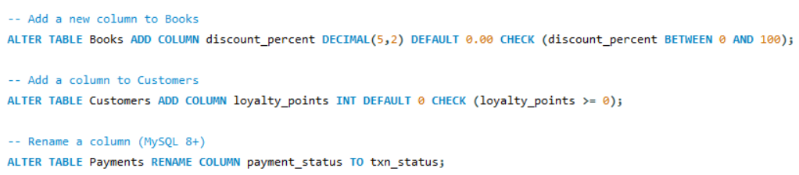
NOTE: Constraints are rules applied to columns in a table to enforce data integrity and ensure the accuracy and reliability of data in the database.

Slide 25
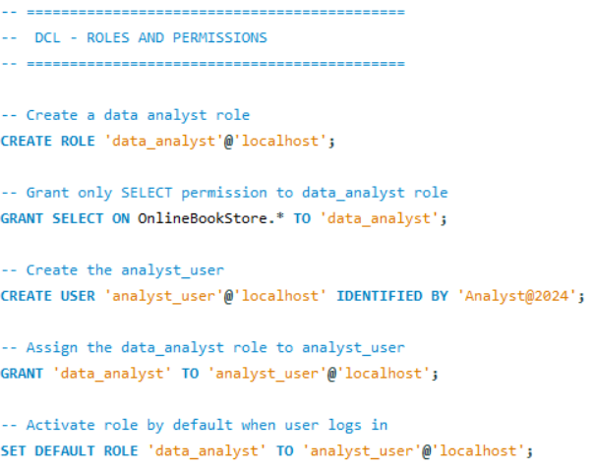
DCL QUERIES:
DCL stands for Data Control Language, a subset of SQL used to control access and permissions on the database. It has two main commands — GRANT which gives permissions to a user, and REVOKE which removes permissions from a user.
In our bookstore project we created a role called data_analyst and granted only SELECT permission so the analyst can only read data but cannot insert, update or delete.
We then assigned this role to analyst_user using the GRANT command and set it as the default role so it activates automatically when the user logs in.
Finally we used REVOKE to remove the DELETE permission from analyst_user to ensure sensitive data stays protected and secure

Slide 26
ENSURE DATABASE CONSISTENCY:
TCL (Transaction Control Language)
Definition: TCL stands for Transaction Control Language. It is a subset of SQL used to manage transactions in a database. A transaction is a group of SQL operations that are executed as a single unit — either all succeed or all fail together. TCL ensures data consistency and integrity during multiple operations.
FOR UPDATE Locked book row during concurrent orders
Command | Purpose
START TRANSACTION | Begins a new transaction
COMMIT | Saves all changes permanently
ROLLBACK | Undoes all changes back to start
SAVEPOINT | Creates a checkpoint inside a transaction
ROLLBACK TO | Rolls back to a specific savepoint only
Concurrent Transactions | Ravi and Priya trying to buy same last book
Temporary Table | Book sales summary for current session only
VIEW | Permanent book performance report view

Slide 27



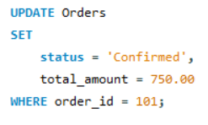
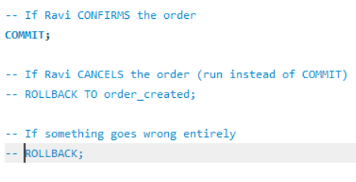
This is how a transaction starts
After the transaction starts we insert the values and after inserting if the order confirms then we commit otherwise we create a save point
If the order isnot confirmed we rollback to the savepoint

Slide 28
AUTOMATE DATABASE OPERATIONS
Stored Procedures
Definition: A Stored Procedure is a pre-written set of SQL statements stored in the database that can be executed whenever needed by simply calling its name. It accepts input parameters, performs operations, and can return results. Stored procedures improve reusability, performance and security of the database.
Key Points:
Uses DELIMITER $$ to change the statement terminator temporarily
IN parameter = input value passed by user
DECLARE is used to create local variables inside the procedure
SIGNAL SQLSTATE is used to raise custom error messages
Called using CALL procedure_name()

Slide 29
Triggers:
Definition: A Trigger is a special SQL program that automatically executes in response to certain events on a table such as INSERT, UPDATE or DELETE. Triggers are used to enforce business rules, maintain data integrity and log changes automatically without any manual intervention.
Key Points:
BEFORE trigger fires before the operation happens OLD refers to the existing row before update or delete
AFTER trigger fires after the operation is completed
NEW refers to the new row being inserted or updated Triggers cannot be called manually — they fire automatically
Events:
Definition: A MySQL Event is a scheduled task that runs automatically at a specified time or interval. Events are used to automate repetitive database tasks like generating reports, cleaning old data or updating records periodically. The Event Scheduler must be enabled for events to run.
Key Points:
SET GLOBAL event_scheduler = ON enables the scheduler
ON SCHEDULE EVERY sets how often the event runs
Events run in the background automatically
Used for automating tasks like daily reports and cleanup jobs
Events improve database automation and maintenance

Slide 30
JSON IN SQL:
JSON Column & Analytics:
Definition: JSON (JavaScript Object Notation) is a native MySQL data type used to store flexible, structured data inside a relational table. When combined with GROUP BY, HAVING and JOIN, it enables powerful analytical queries that summarize and filter data across multiple tables.
JSON Document Queries (xDevAPI Style)
Definition: MySQL supports document store functionality where JSON documents can be stored and retrieved using collection-style queries. This bridges the gap between NoSQL and SQL — allowing JSON documents to be queried with filter, sort, and limit operations just like a document database.
Key Points:
JSON columns store flexible key-value data without fixed schema
JSON_EXTRACT() or ->>'$.key' retrieves specific fields from JSON
JSON_SEARCH() searches inside JSON arrays
JSON_LENGTH() checks the size of a JSON array
Results can be filtered, sorted and limited just like regular SQL

Slide 31
Thank you
Kancharla Ramya
NIIT Institute
ramyakancharla51@gmail.com

